Slide 1
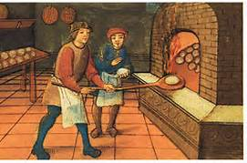
The Truth About Consequences: What Really Motivates People
The Apprentice Model
T
Notes:
The Apprentice Model is a way to organize all we do in a simple way to help others to be motivated. Apprentices are not punished when they make a mistake, they are taught.
What is implicit in the apprentice model is that they cannot do the behavior yet. They have to learn it. Implicit in the behavioral model is that people are not motivated to do the behavior but they can.

Slide 2
Breaking News
Human Behavior is Complicated

Slide 3
The Map of Strategic Self Regulation
Background
Noise
Perception of Event
Feelings
Thoughts
Behavior
Consequence
Proactive Strategies
Problem
Solving
De-
Escalation
Causes of Behavior
Interventions

Slide 4
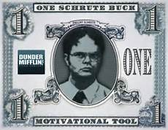
Applying Consequences in the Adult Work Place
Schrute bucks video

Slide 5
Why do people do things like:
Leo picture Elia picture
Ukelele Rocks
Notes:
What do these things have in common?
Where is the external reward in these things?

Slide 6
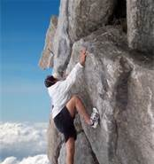
“The Activities are Their Own Reward”

Slide 7
Human Motivation Theory
Human behavior is determined by using a “Risk-Benefit” analysis of what we stand to gain, and what we stand to lose by a particular behavior.
Notes:
A fundamental tenet of motivation research and theory has been that people make choices based on a cost benefit analysis of what they stand to gain and what risk they are taking in pursuit of that goal.
The absence of external rewards such as pay, working conditions, and job security led to dissatisfaction among workers, but their presence did not lead to satisfaction.

Slide 8
Basics of Behavioral Treatment
Rewarding an activity behavior or behavior will get you more of it.
Punishing an activity will get you less of it.
TRUE?
Notes:
Certainly not as predictable as we would like it to be.

Slide 9
The Hierarchy Of Motivation
Intrinsic Relatedness Now-That
Autonomy
Mastery
Purpose
2. Extrinsic Carrots & Sticks If-Then
1. Biological Food, Drink, Safety
Notes:
Motivation is often considered a singular construct rather than a hierarchy. So discussion in the infant study was not about what type of motivation was driving behavior but rather about

Slide 10
The Dangers of Mis-Applying Motivational Theory
Child Development, Bell & Ainsworth, 1972
Notes:
Here’s a case of mixing up biological motivations with extrinsic motivation and applying extrinsic motivational strategies to biological motivations.

Slide 11
The Infant Study
Hours of 2-
Crying
Biological Extrinsic
Baseline

Slide 12
The Infant Study
3.5
Hours of 2
Crying
week 6 52
Biological Extrinsic
Post Treatment
Notes:
By picking up baby and treating help them learn to discriminate states and lessen crying.

Slide 13
The Infant Study
3.5
Hours of 2
Crying
week 6 52
Biological Extrinsic
Post Treatment
Notes:
By picking up baby and treating help them learn to discriminate states and

Slide 14
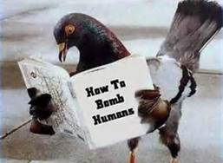
The Roots of Behaviorism
BF Skinner education video
Notes:
Pick apart part 1, segment 1. He talks about not being dependent on SR+ for long term yet most programs that run on these principles use them without any thought of how to get rid of them. This may be the most important and condemning principle to behavioral programs.

Slide 15
The Unpredictable Results of Reinforcement
Undermining Children’s Intrinsic Interest with Extrinsic Rewards (Lepper, Green, & Nesbitt)
Rewards Expected Unexpected No
Time 8.59 18.09 16.73
Quality 2.18 2.85 2.69
Notes:
Children who showed intrinsic interest in the activity were selected.
Experiment done.
This time data is from 2 weeks after the trial and is a measure of the subsequent interest in the activity.

Slide 16
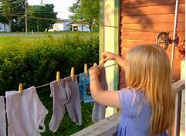
Extrinsic rewards undermine altruistic tendencies in 20-month-olds.
http://www.youtube.com/watch?v=Z-eU5xZW7cU

Slide 17
The Effects of Reinforcement on Altruism
In kids
% Help
No Praise Praise Reward
Warneken, F., & Tomasello, M. (2008). Developmental Psychology, 44 (6), 1785-1788
Notes:
Need to get this study in order to get the exact numbers for graph.

Slide 18
The Effects of Reinforcement on Altruism
“A Feeling That Money Can’t Buy”
%
none 50K charitable
rewards
Journal of the European Economic Association, June 2008

Slide 19
The Effect of Reinforcement on Creativity & Problem Solving
9 games involving creativity, memory, motor skills
Rewards: equivalent to 1 day, 1 month, 6 months pay for average villager Madurai India
Total %
Maximal
Earnings
Review of Economic Studies, 2009, Ariely et al
Notes:
These numbers are a summary of percentage of maximal earnings taken from table 3 by adding numbers for each group

Slide 20
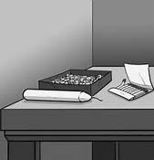
The Effects of Reinforcement on Creativity
The candle problem: Glucksburg, 1962, J. Exptl Psychology
Notes:
J. of Experimental Psychology, 1962, Glucksburg
We need to get the original study in order to summarize the data. Incentivized group took 3.5 minutes longer to complete the task. How long in comparison was that?
Both studies are contained in Glucksberg ‘62, tacks in box and out.

Slide 21
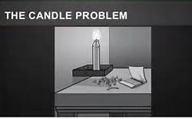
Solution

Slide 22
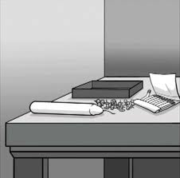
The Effects of Reinforcement on Creativity
The candle problem for dummies

Slide 23
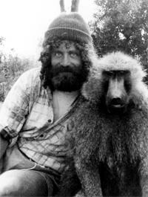
The Effects of Reinforcement on Dopamine
http://www.ted.com/talks/robert_sapolsky_the_uniqueness_of_humans.html

Slide 24
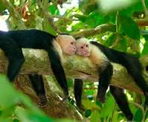
The Social Effects of Reinforcement
Two Monkeys Were Paid Unequally Excerpt from Frans de Waal Ted Talk

Slide 25
Reinforcement Summary
“Careful consideration of reward effects reported in 128 experiments lead to the conclusion that tangible rewards tend to have a substantially negative effect on intrinsic motivation”.
When institutions-families, schools, businesses, and athletic teams for example focus on the short term and opt to control peoples behavior, they do considerable long term damage.
Psychological Bulletin, 1999, Deci, et al

Slide 26
The beatings will continue until morale improves…How about punishment

Slide 27
The Unpredictable Results of Punishment
# late-coming parents
20 exptl
16.2 17.2
10
control
9 8
4 FINE 16

Slide 28
The Map of Strategic Self Regulation
Background
Noise
Perception of Event
Feelings
Thoughts
Behavior
Consequence
Proactive Strategies
Problem
Solving
De-
Escalation
Causes of Behavior
Interventions
Notes:
To illustrate that the action is really in the yellow squares ask what is going on. The consequence actually causes a shake up up front.

Slide 29
The Effects of Punishment on “The Punisher”
Power, Moral Clarity, and Punishment in the Workplace ACAD MANAGE J amj.2010.0960; Scott Wiltermuth
psychologists found a neat way to make sure that punishment is always effective in changing behavior – by definition.

Slide 30
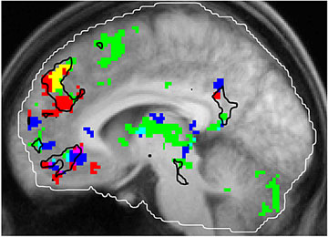
Differential Effects on Brain Activation of Reward and Punishment
J. Neuroscience, 2001, Knutson et al
Notes:
Insert 2nd set of brain pictures.
Point is that anticipation of reward and punishment lights brains up differently.
Figure 3 a (reward) & c (punishment)

Slide 31
What do we do if Tasks are just not interesting?
Rewards do not undermine people’s intrinsic motivation for dull tasks because there is little or no intrinsic motivation to be undermined!
-Deci, Ryan, & Koestner
1. Give a good reason for doing the task.
2. Admit it’s not fun.
3. Let them do the task in an interesting way.
4. Give a hand!

Slide 33
The Hierarchy Of Motivation
Intrinsic Relatedness Now-That
Autonomy
Mastery
Purpose
2. Extrinsic Carrots & Sticks If-Then
1. Biological Food, Drink, Safety

Slide 34
Goals
1. Intrinsic -- Engagement
2. Extrinsic -- Compliance
3. Biological -- Meet Basic Needs

Slide 35
Drivers of Intrinsic Motivation
1. Autonomy: the desire to be self directed.
2. Mastery: the desire to get better and better at something that matters.
3. Purpose: to work towards something greater than the self.
4. Relatedness: the need to feel belongingness and connectedness with others.

Slide 36
The Apprentice Program
Apprenticeship is a system of training a new generation of practitioners of a structured competency a basic set of skills.

Slide 37
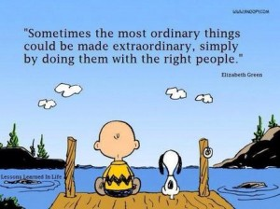
Relatedness
Notes:
PTSD MV example of perspective taking.
Robert Patrick example of relatedness being the foundation of motivation, not cigarettes. Not motivated to do anything until relationship mileau changed.

Slide 38
Relatedness
The most critical element is perspective taking, taking on the others point of view, an impossible task.
That can only be achieved by listening.
Relatedness is dependent upon access and maintainence of the conversation which implicitly implies status and importance.
Conversations deliver the message whether mastery, autonomy, and purpose , or control will be used.
Advise don’t direct.
Give the behavior a frame of reference, why do we want it done.
Notes:
PTSD MV example of perspective taking.
Robert Patrick example of relatedness being the foundation of motivation, not cigarettes. Not motivated to do anything until relationship mileau changed.

Slide 39
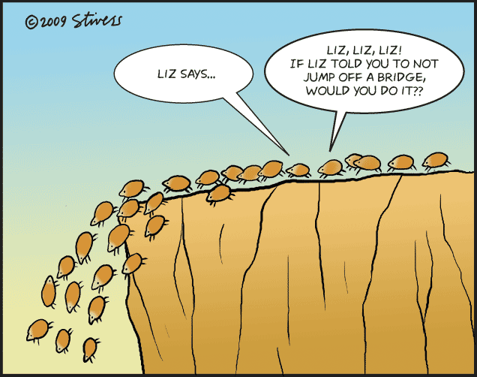
Autonomy

Slide 40
Autonomy
Allow them to do it their way even if it isn’t our own.
Help them figure out how they want to do things.

Slide 41
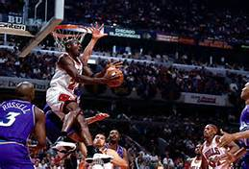
Mastery

Slide 42
Mastery
Talk about growth, even during setbacks.
Always talk about things in the context of changes that have occurred.
Ask people to do what they are capable of and no more. Vygotsky’s zone of proximal development. Stage model.
Don’t ask people to behave, ask them to learn.

Slide 43
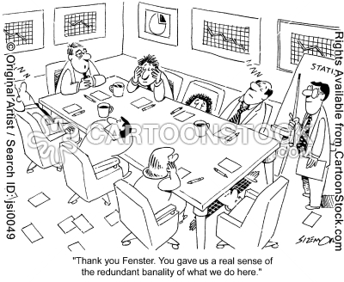
Purpose

Slide 44
Purpose
The presence of rewards or punishments creates doubt as to the true motive for which good deeds are performed, and this “overjustification effect” can result in a net crowding out of prosocial behavior by extrinsic incentives.
-Roland Benabou
What is the larger context or goal.
Purpose is not how, but why.
The 1 sentence goal.

Slide 45
The Map of Strategic Self Regulation
Background
Noise
Perception of Event
Feelings
Thoughts
Behavior
Consequence
Proactive Strategies
Problem
Solving
De-
Escalation
Causes of Behavior
Interventions

